Slide 1
Pew Pew!
Project presentation for Microsoft® NUI OOBW, April 2013
An original shooting game for Microsoft® Kinect

Slide 2
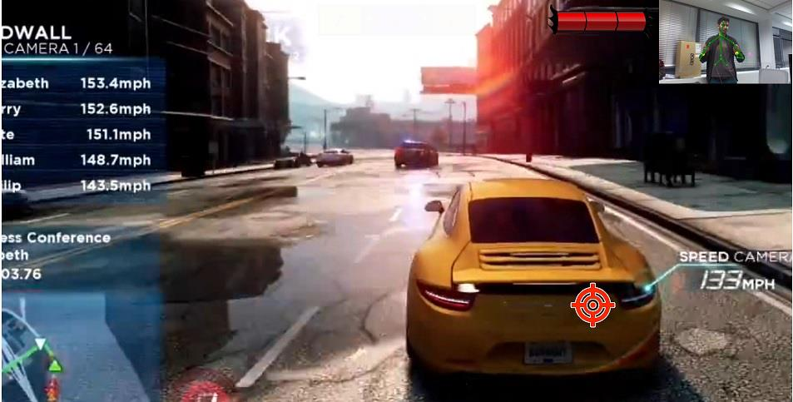
Use your controller to shoot the escaping car!

Slide 3
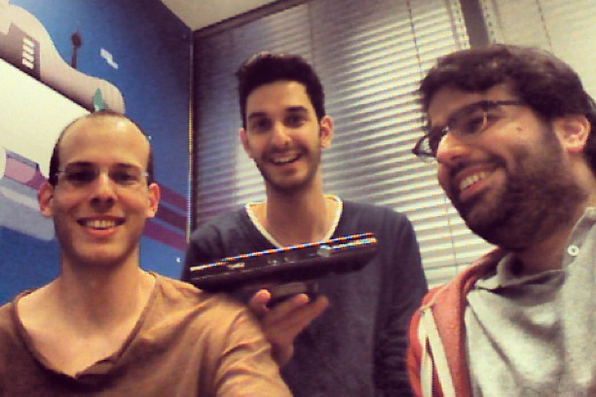
The team
Sagie Maoz
3rd year Computer Science & Linguistics student, Tel Aviv University.
Software developer at Waze.
Amir Moualem
3rd year Computer Science & Economics student, Tel Aviv University.
Software Developer at eToro.
Shay Malchi
3rd year Computer Science & Management student, Tel Aviv University.
Software Developer at Verint.

Slide 4
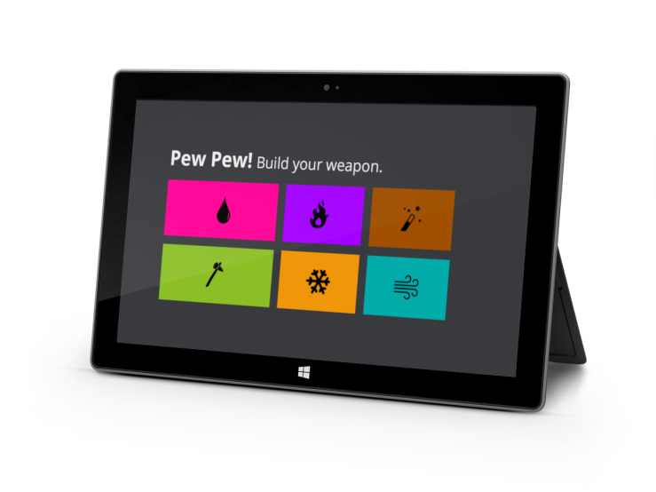
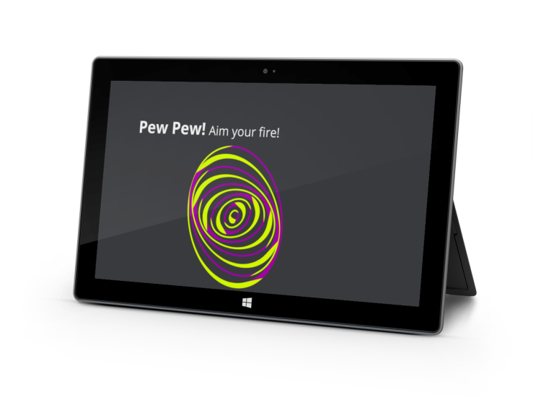
Our idea
Step 1
Build your weapon
An interactive NUI shooting game, integrating the Kinect sensor with a tablet as the game’s controller. The player will be able to move around, combine special weapons in order to fire the correct combination at a moving target. The project was developed under the supervision of Prof. Lior Wolf, who also contributed the game’s idea.
Step 2
Aim your fire

Slide 5
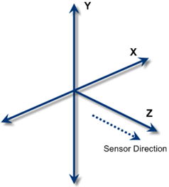
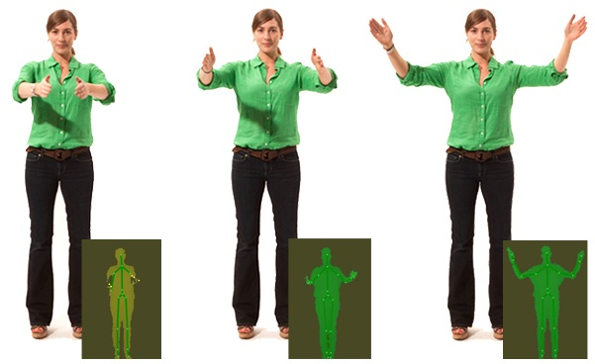
Calibration
Uses the player’s hands position to assist NUI aiming in a 3D environment.
Client-Server topology to communicate the chosen weapon.
Using Kinect data in calculations to verify the shot is within the target radius.

Slide 6
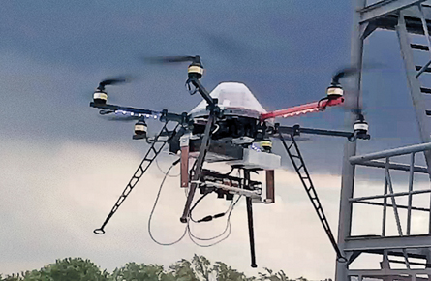
Technology used
Microsoft Kinect SDK
Microsoft Windows Presentation Foundation
Rich HTML5 features on Internet Explorer 10
Microsoft Windows 8 for PC & Surface
Microsoft Team Foundation Server (Source Control)
Microsoft Visual Studio 2012

Slide 7
Shooting time!

